Slide 1
Software Engineering
Lecture # 19
Fakhar Lodhi

Slide 2
Recap

Slide 3
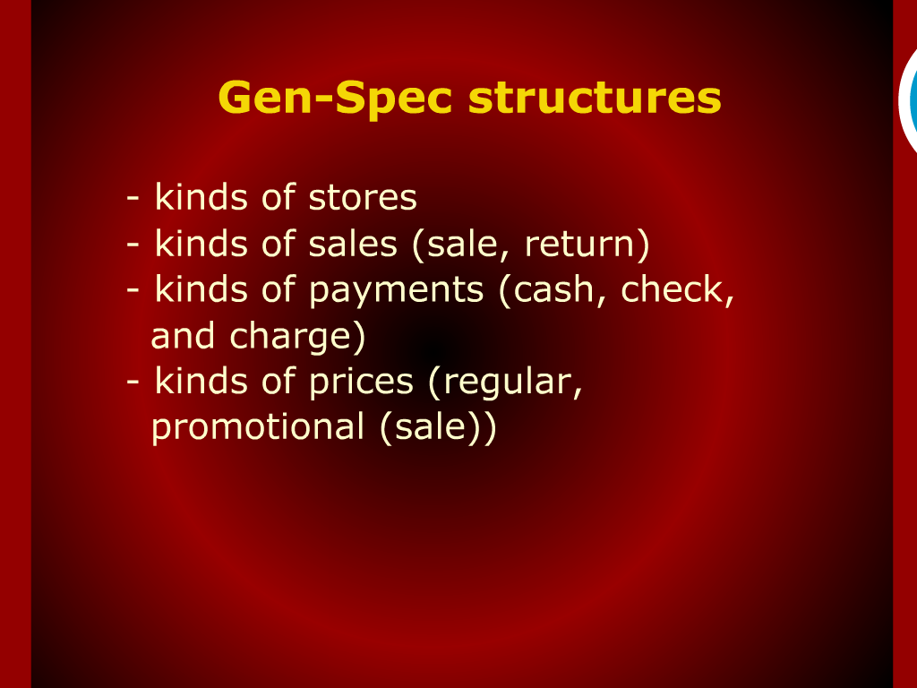
Gen-Spec Structures

Slide 4
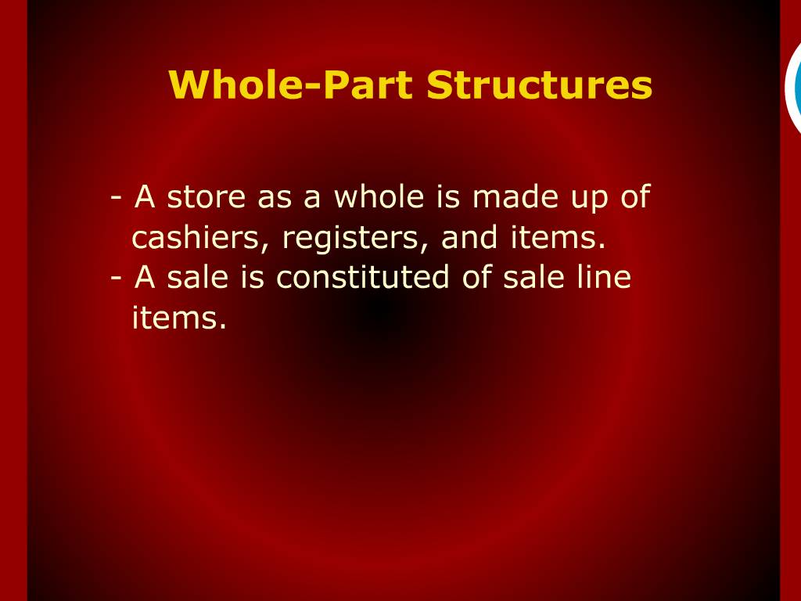

Slide 5
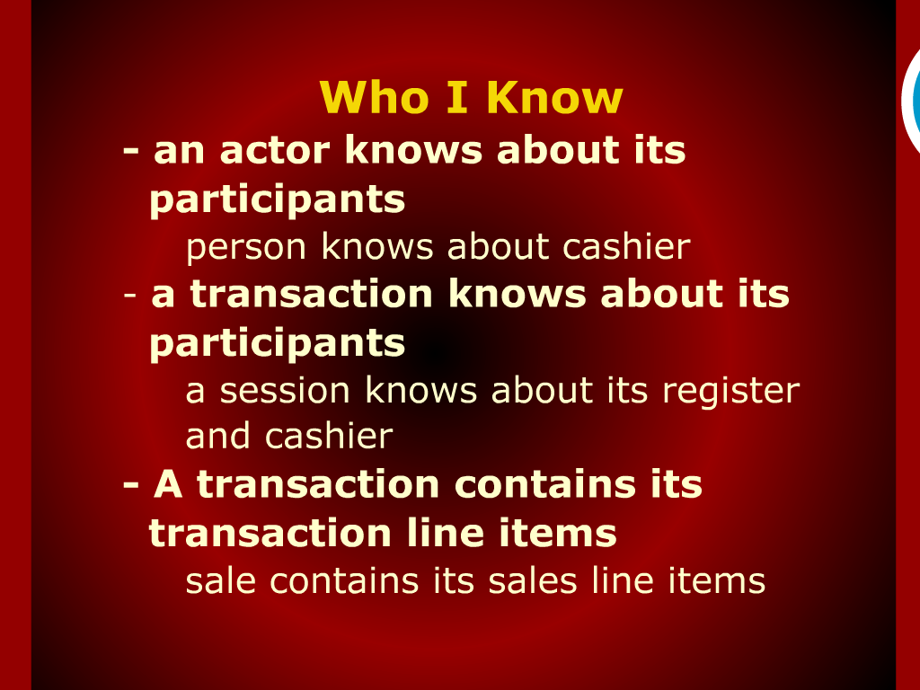
Who I Know

Slide 6
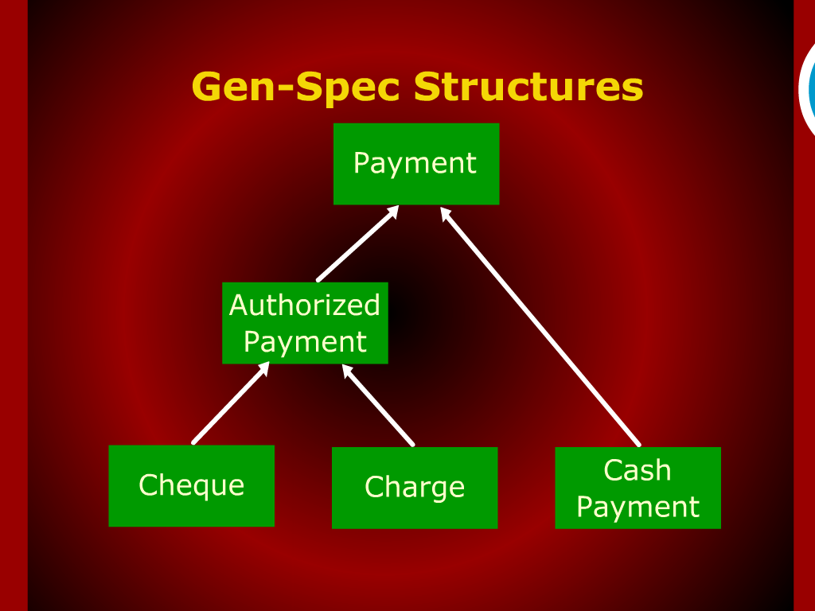
Gen-Spec Structures

Slide 7
Gen-Spec Structures

Slide 8
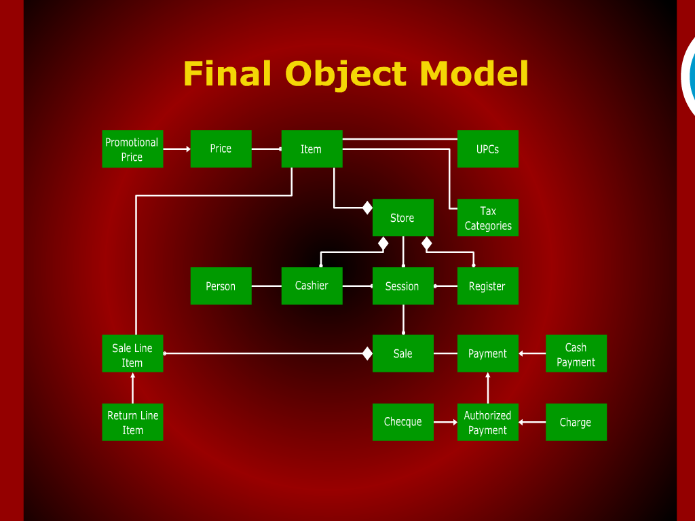
Final Object Model

Slide 9
Gen-spec Structures

Slide 10
Establishing Responsibilities

Slide 11

Who I know

Slide 12
Identify Structures

Slide 13
Who I Know?
A transaction knows its sub transaction
Session knows about its Sales
Sale knows about its Payments

Slide 14
Object Model
Person
Store
Tax Category
Cashier
Session
Register
Payment
Sales

Slide 15
Who I Know?
A place knows about its transactions
store knows about its Sessions
A container knows about its contents
store knows about its Cashiers, items, and registers

Slide 16
Responsibilities
Actor (Person)
Attributes
Name
Address
Phone

Slide 17
Responsibilities
Participant (Cashier)
Attributes
Number
Date
Time
Password
Authorization level
Current session

Slide 18
Responsibilities
Services
Are you authorized?
Assess performance.

Slide 19
Responsibilities
Place (Store)
Attributes
Name
Items
Cashier
Services
Get information about items
Get information about cashier

Slide 20
Responsibilities
Other tangible things
Item
Attributes
Price of an item
Number
Description
Tax
Universal product code
(UPC) for identification

Slide 21
Responsibilities
Services
Get price of the item
Quantity
Total
Sale Line Item

Slide 22
Transaction Objects
Sale Line Items
Date and time
Quantity
Tax status
Calculate subtotal
Item
Sale

Slide 23
Transaction Objects
Returns
Reason for return
Return date and time
Price at the time of return

Slide 24
Transaction Objects
Sale
Identification (date and time)
Calculate subtotal
Calculate total
Calculate discount
Calculate total

